Slide 1
ALGORITHM ANALYSIS
Cloud Storage
Optimization
Minimizing the total cost of merging files
Timothy Moisio
Kallan Fuchs
Benito Aguero
A greedy algorithm: baseline scanning vs. min-heap
Notes:
Target time: 20 seconds. Introduce the task and the comparison. The central question is how to merge all files at minimum total cost without spending too much time finding the next pair.

Slide 2
1. The problem
The order of merges changes the total cost.
Input
Merge rule
Goal
A list of N positive file sizes, such as [10, 30, 35, 60].
Only two files can be merged at once. Cost = sum of their sizes.
Choose a merge order that minimizes the sum of all merge costs.
A combined file may be merged again, so a poor early choice can increase later costs.
2
Notes:
Target time: 40 seconds. Define input, operation, and objective. The cost of each merge is added to the running total; the final file size alone is not the objective.

Slide 3
2. Our strategy
Greedy choice: always merge the two smallest files.
1
→
2
→
3
→
4
Pop two minimums
Combine
Add cost
Push and repeat
The min-heap exposes the smallest value at its root.
Add the two sizes to create the new file.
Add the new file size to the running total.
Reinsert the new size until one file remains.
The heap is not fully sorted; it guarantees the minimum is at index 0.
3
Notes:
Target time: 55 seconds. Explain compute_cost and the custom heap_push and heap_pop. A min-heap maintains the parent <= children property; it does not sort every element. That is enough to access the smallest efficiently.

Slide 4
3. Example: follow the merge costs
Starting sizes: [10, 30, 35, 60, 85, 90]
Files merged
New size / cost
Running total
10 + 30
40
40
35 + 40
75
115
60 + 75
135
250
85 + 90
175
425
135 + 175
310
735
Total cost = 40 + 75 + 135 + 175 + 310 = 735
4
Notes:
Target time: 55 seconds. Show how the two smallest available sizes are chosen each time. The correct sequence produces costs 40, 75, 135, 175, and 310, totaling 735. This corrects the arithmetic in the original reflection draft.

Slide 5
4. Why use a min-heap?
The greedy rule is the same; finding the two minimums is different.
Baseline: repeated scan
Min-heap implementation
Each round scans the remaining list to find the two smallest files, then merges them.
Each push/pop takes O(log N). Each round uses two pops and one push.
Θ(N²)
Θ(N log N)
There are N − 1 merges. Replacing repeated linear scans with heap operations improves scaling.
5
Notes:
Target time: 1 minute. For the baseline, finding minimums costs linear time per round and there are N−1 rounds, so the total is Theta(N squared). For the heap solution, there are O(log N) push/pop operations per round across N−1 rounds, plus heap construction by repeated pushes in this implementation, so the overall bound remains O(N log N).

Slide 6
5. How we checked correctness
pytest tests the returned costs; benchmarking measures speed.
Baseline test
Heap test
Agreement test
Checks a fixed seeded 10-file input returns 9945.
Checks the heap implementation returns 9945 for the same seeded input.
Checks both algorithms return the same cost on the same input.
6
Notes:
Target time: 45 seconds. Explain the role of a fixed random seed and the three tests. Do not say the tests prove all possible inputs are correct; they provide useful checks for one reproducible case. Empty input currently is not handled correctly by these implementations.

Slide 7
6. Benchmarking design
We timed both approaches on random lists of increasing size.
Input sizes
Timing method
Charts
100 to 6,400 files, doubling each step.
10 runs per size; record the average runtime.
Linear scale and logarithmic y-axis scale.
7
Notes:
Target time: 45 seconds. Be precise about the benchmark setup in the code shared with us. It uses 100, 200, 400, 800, 1600, 3200, and 6400. The report's 50000 and 25x claims need verification against the actual graph and code version.

Slide 8
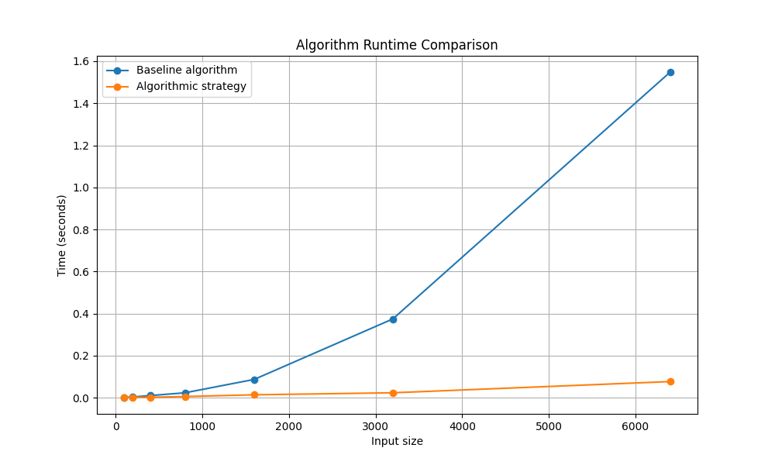
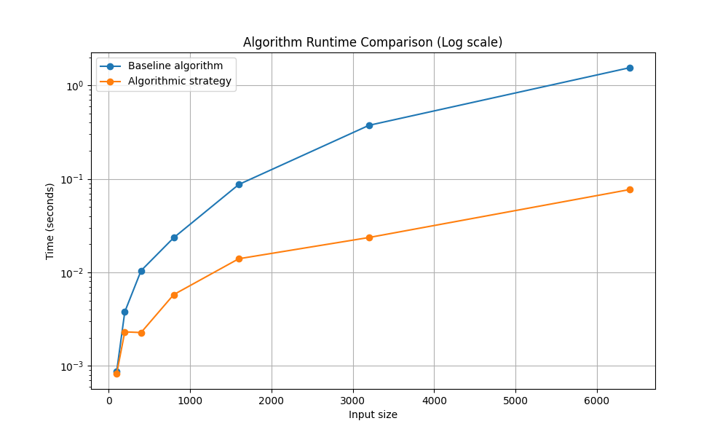
7. Results: connect theory to evidence
Replace the placeholders with the final benchmark graphs.
Linear scale
Logarithmic y-axis
Interpretation to test against the graphs: the baseline should grow faster; the heap should scale more slowly.
8
Notes:
Target time: 1 minute. Insert the real graphs before presenting. Describe the actual visible trends, not just the theoretical prediction. Do not state an exact speedup unless it can be read from the final measured data. In the code shown, each algorithm gets separate randomly generated lists, so for a fairer comparison use identical seeded inputs for each pair of timings.

Slide 9
8. What we learned
The main improvement was a change in data structure, not the merge rule.
Challenge
Design pivot
Takeaway
Our first approach did not scale better than the baseline.
Switching to a min-heap reduced repeated minimum-search work.
Correctness tests, complexity analysis, and benchmarks answer different questions.
Questions?
9
Notes:
Target time: 40 seconds plus Q&A. Conclude that data structure choice changed the runtime while preserving the greedy strategy. Invite questions. For defense, be honest about limitations in testing and benchmark consistency.

